Slide 1

Authoring experience
HAX

Slide 2


Bryan Ollendyke
@btopro
Penn State College of Arts & Architecture

Slide 3
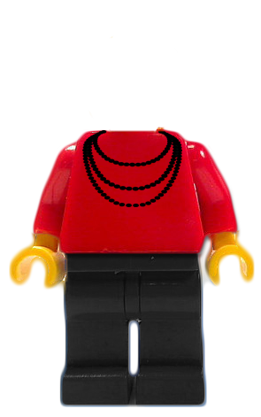
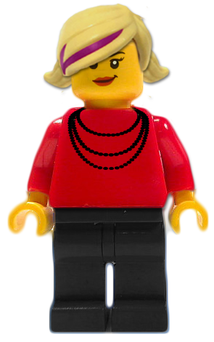
Nikki Massaro Kauffman
Programmer / Analyst

Slide 4

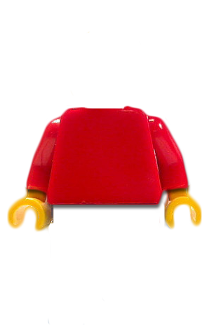
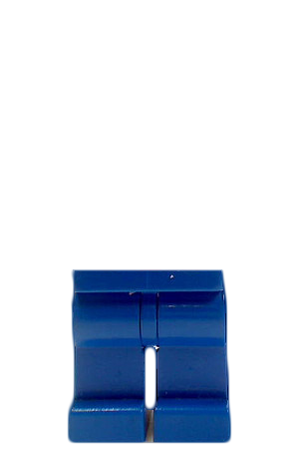
Authoring
eXperience?

Slide 5

What is Authoring Experience?

Slide 6
Empathy for the builders.
Empathy for the end users.

Slide 7
UX for Drupal Admin

Slide 8

Builders are users, too!

Slide 9
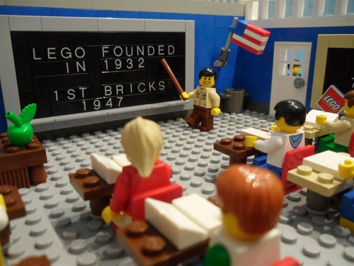
End user Experience

Slide 10
Drupal’s Authoring Problem

Slide 11
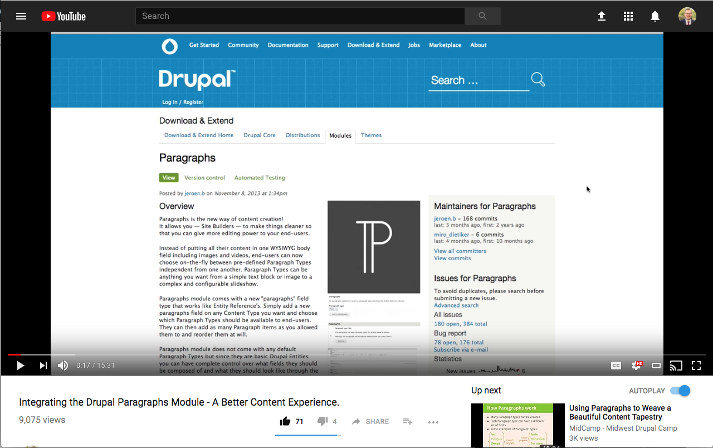

Slide 12
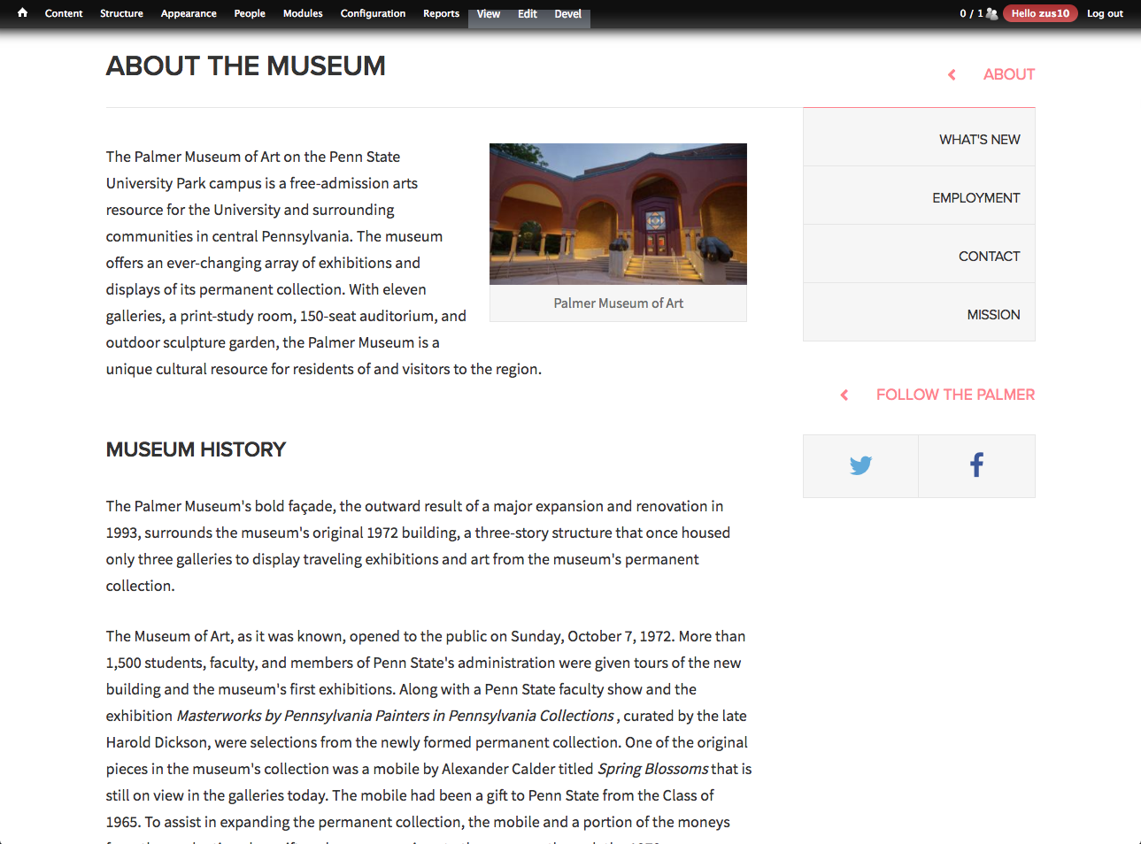

Slide 13
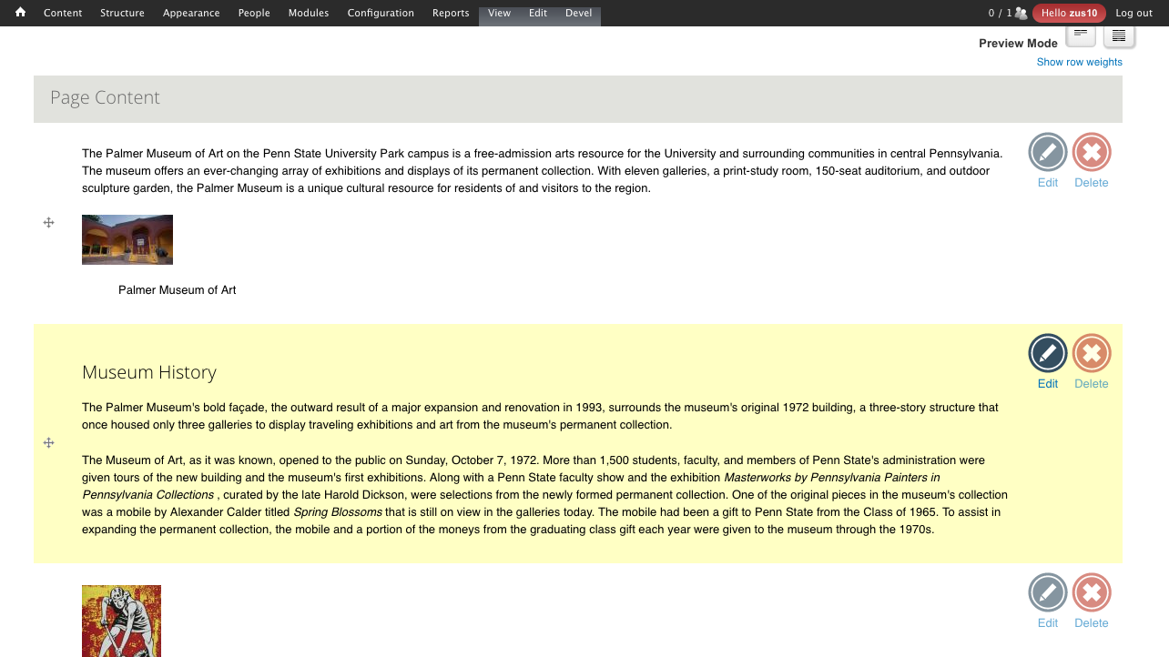

Slide 14
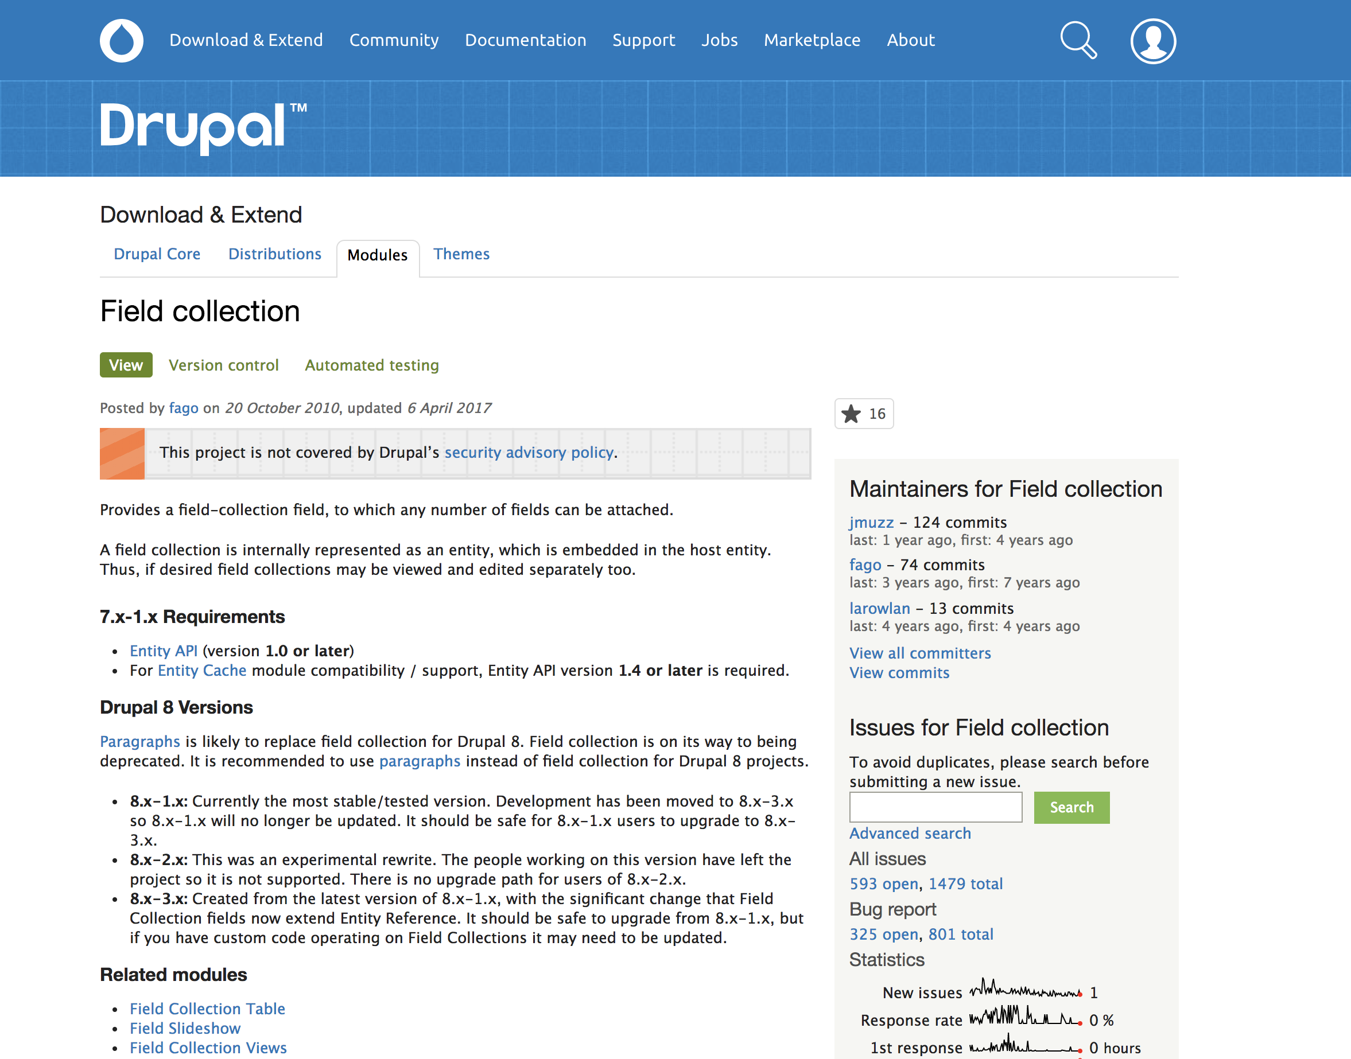

Slide 15
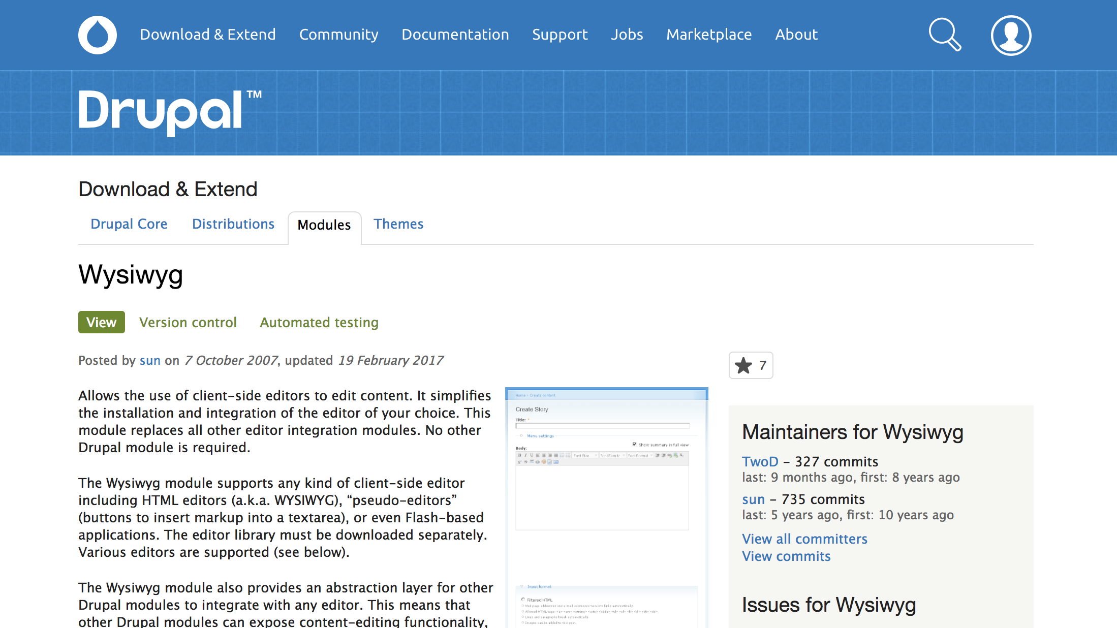

Slide 16
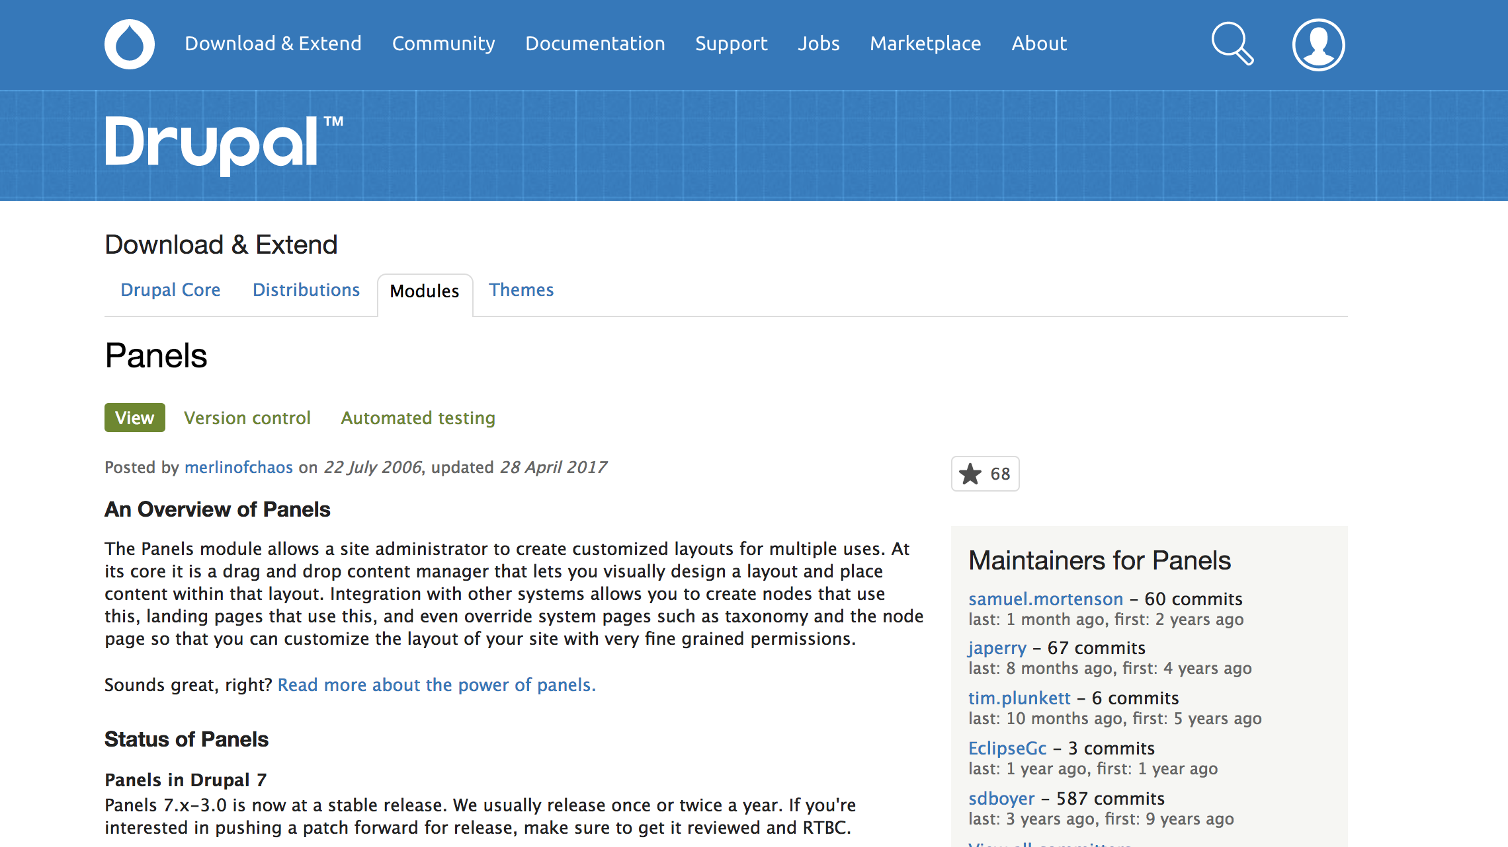

Slide 17
Yeah?

Slide 18
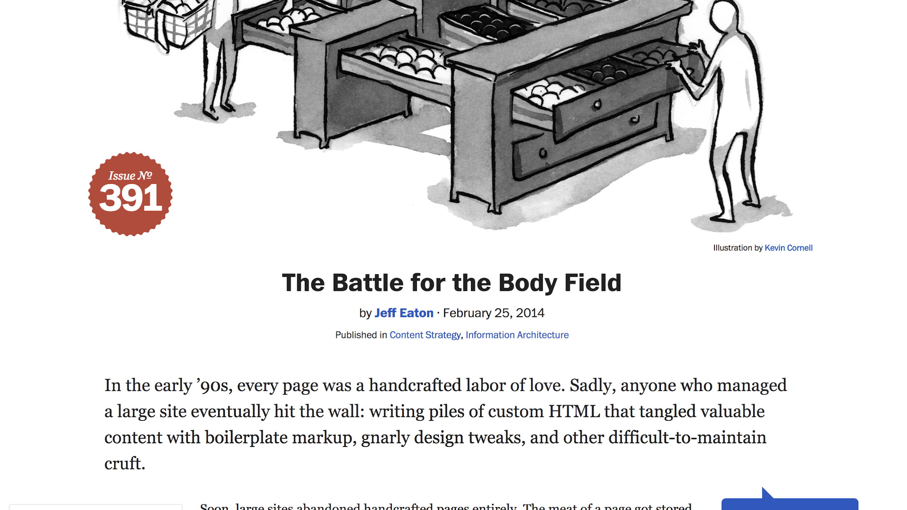

Slide 19
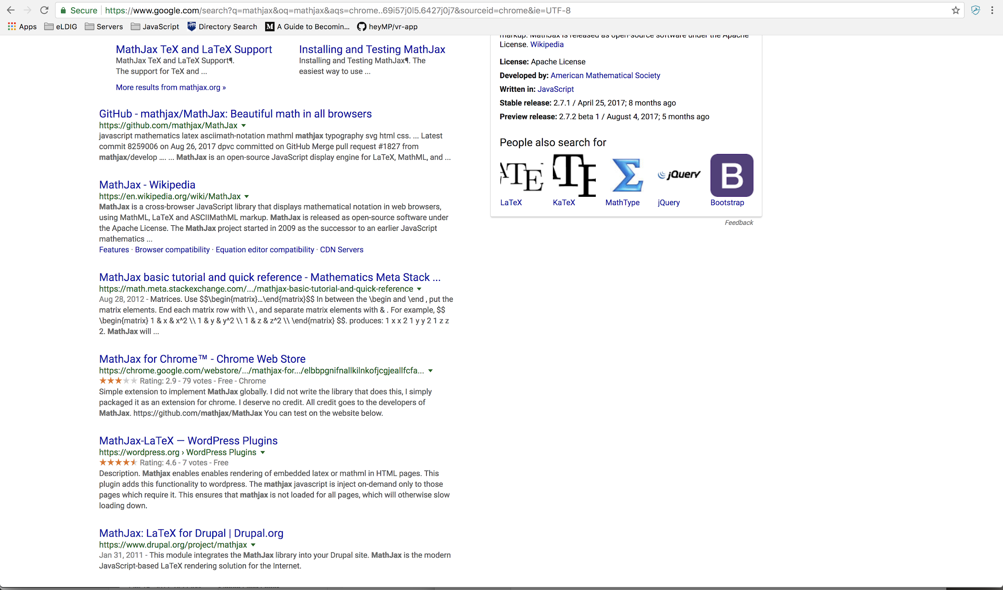

Slide 20
Drupal is your backend

Slide 21
Try THE new paradigm

Slide 22

uniform COmponents

Slide 23



Oh so these then?

Slide 24
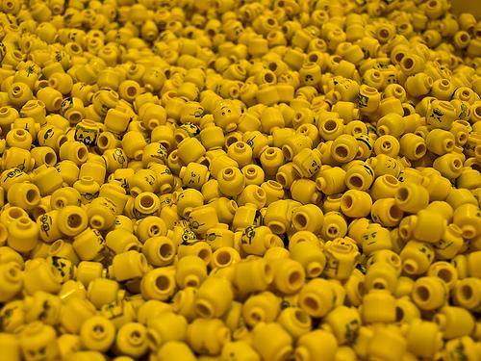

We don’t need a framework!
the web is the platform!!!

Slide 25

Wait, what is “the platform”?

Slide 26
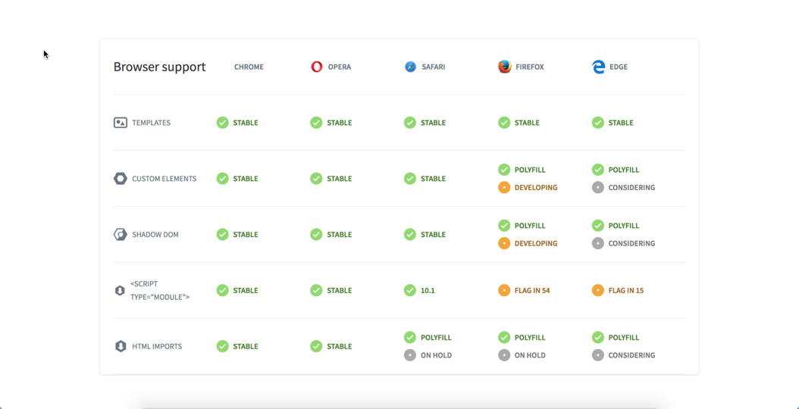
The web is the platform!

Slide 27
This meta spec is web components!

Slide 28
U-VASE
U nderstanding
V ia
A
S illy
E xample

Slide 29
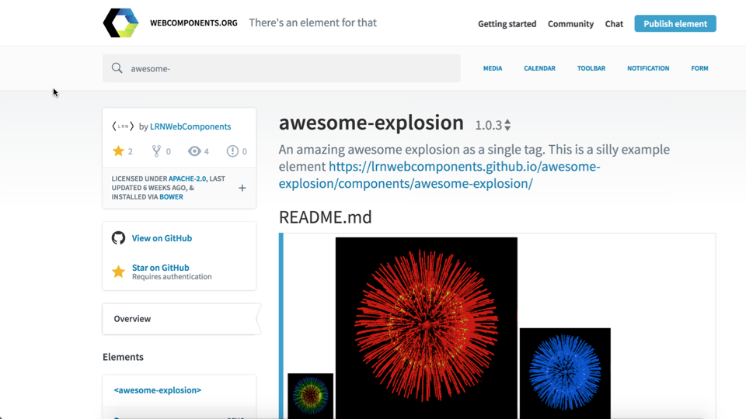

Slide 30
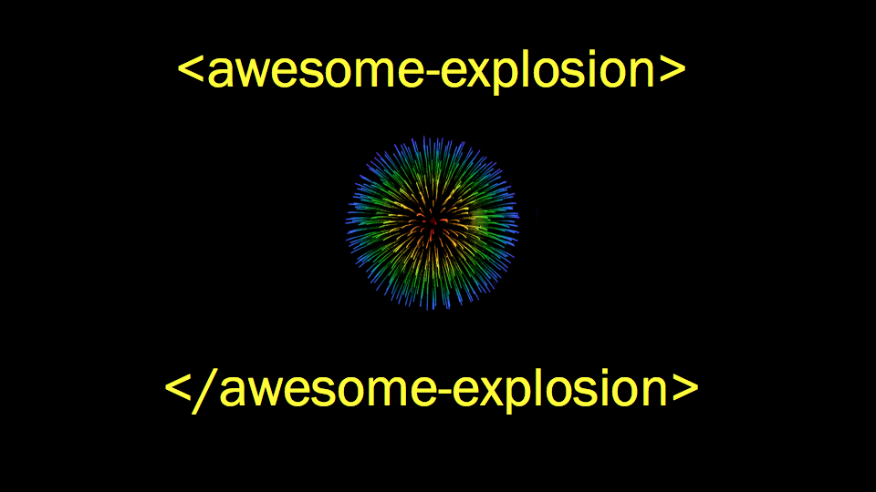

Slide 31
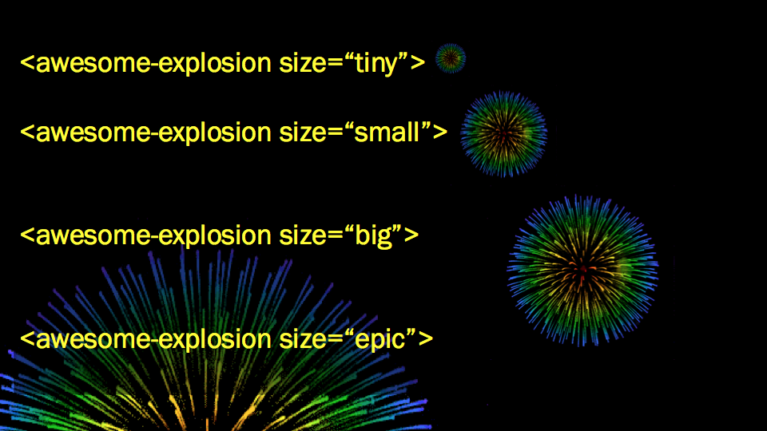

Slide 32
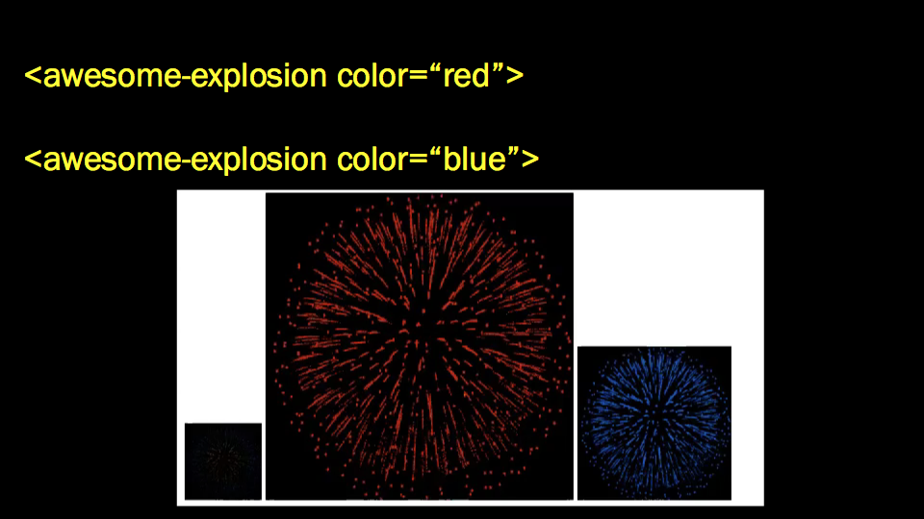

Slide 33
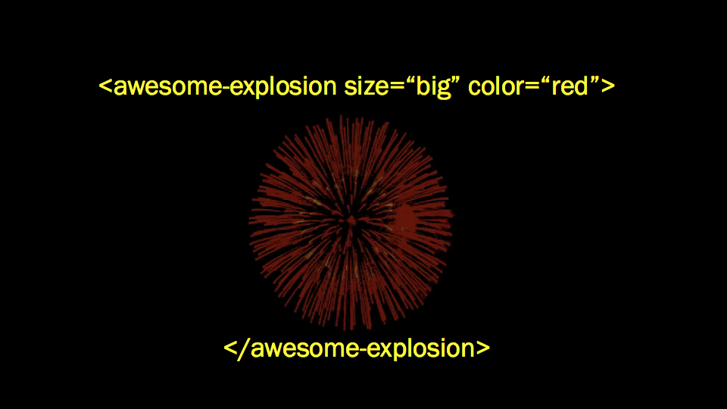

Slide 34
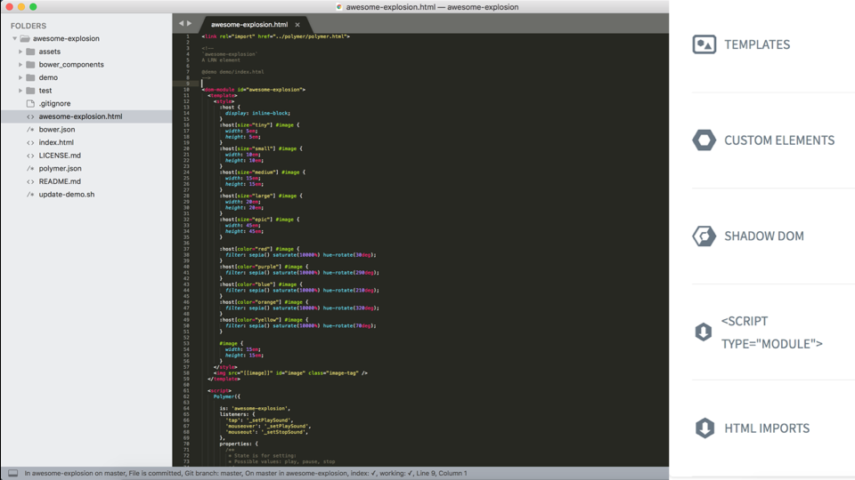


Slide 35
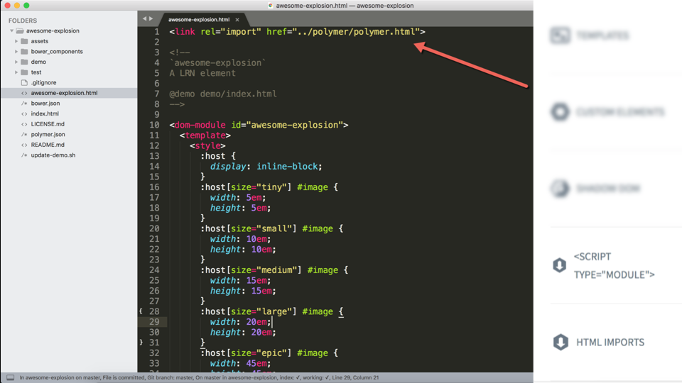

Slide 36
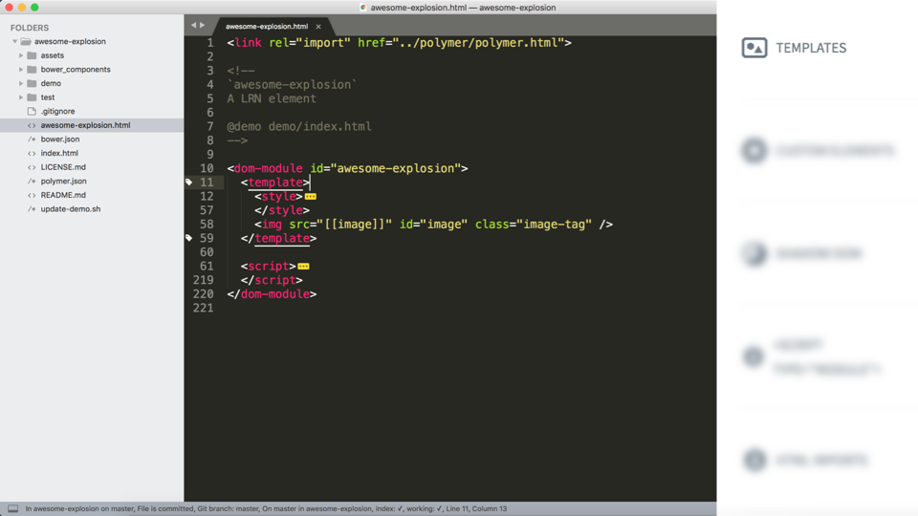

Slide 37
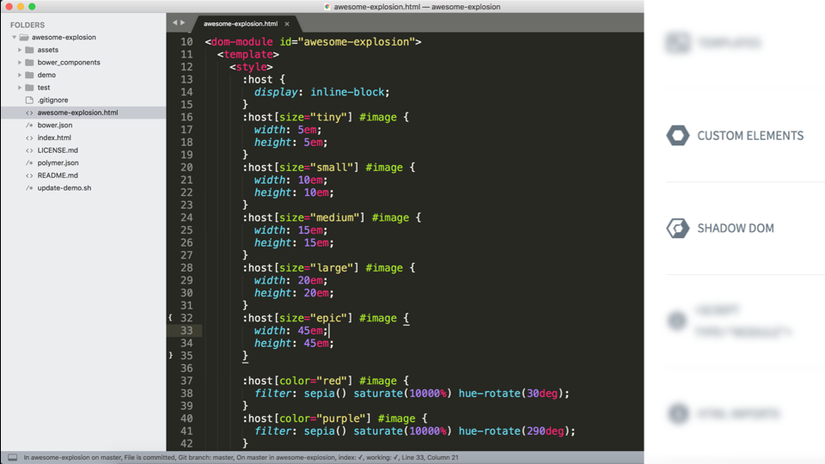

Slide 38
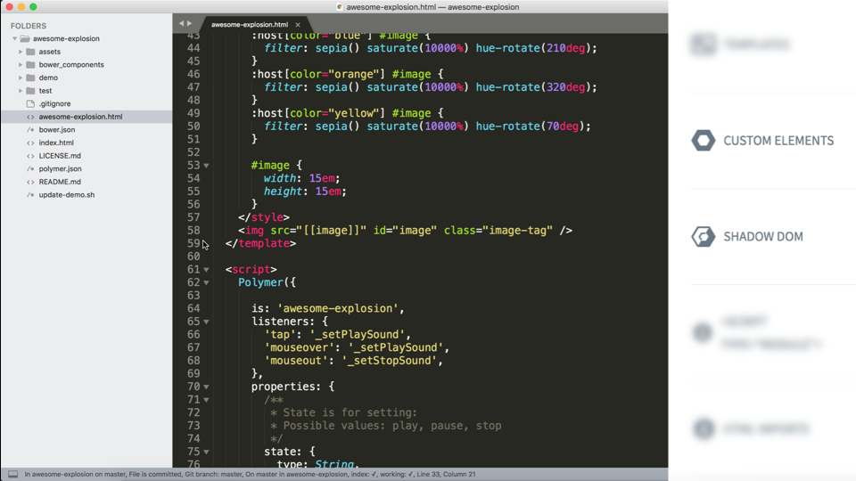

Slide 39
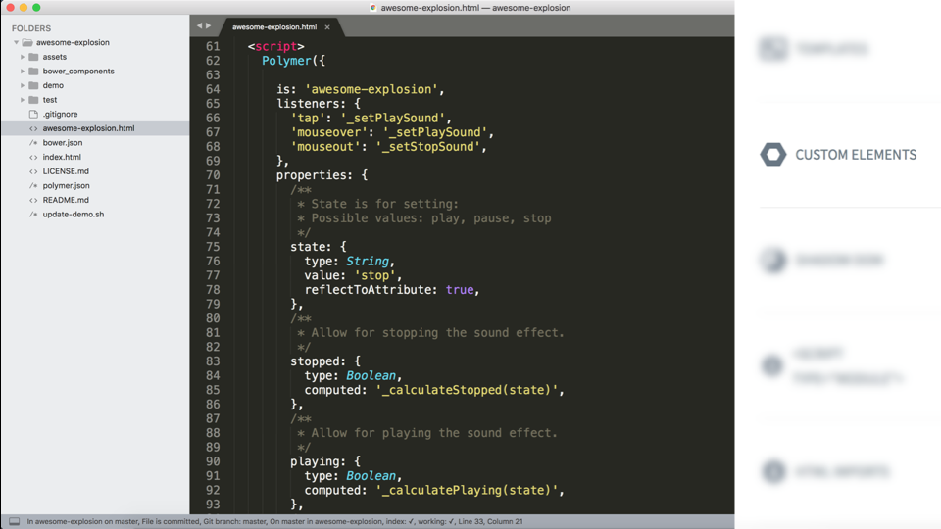

Slide 40
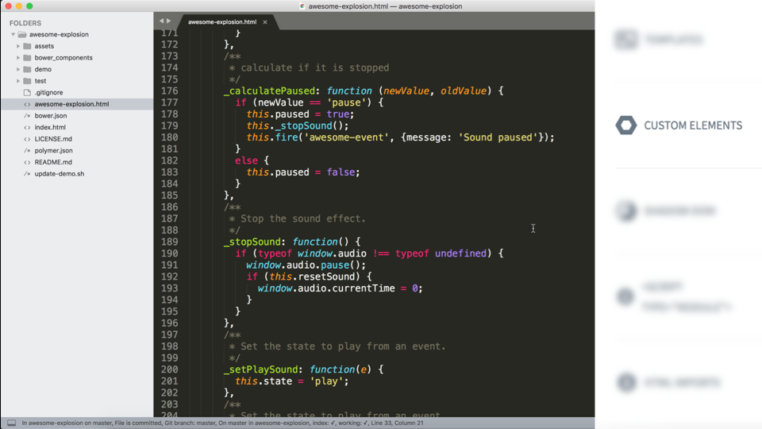

Slide 41
Why web components?

Slide 42

Component Uniformity

Slide 43

Cross library Collaboration

Slide 44
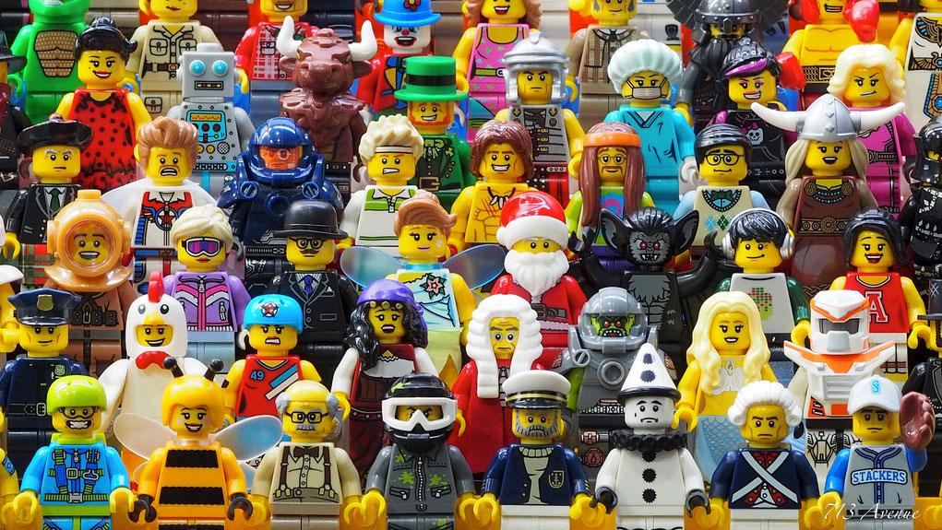
Accessibility

Slide 45






Cross CMS / project dev!!!!!!!!
6
7
8

Slide 46
What can we build now?

Slide 47
POTTER STUFF HERE

Slide 48
So...what about
Authoring
eXperience?

Slide 49





HAXtheweb.org

Slide 50
What is HAX?

Slide 51
Headless
Authoring
eXperience!

Slide 52

HAX concepts

Slide 53


HAX Gizmos
A gizmo is ANY web component that fires an event HAX understands!
We can leverage existing elements and wire to HAX in minutes!

Slide 54
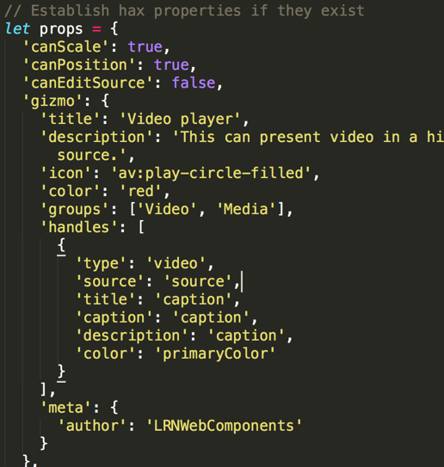
Gizmo JSON: How it looks

Slide 55
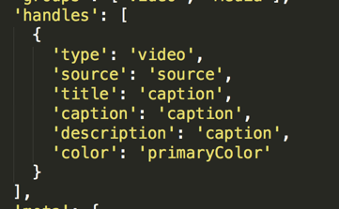
Gizmo JSON: Types it handles

Slide 56
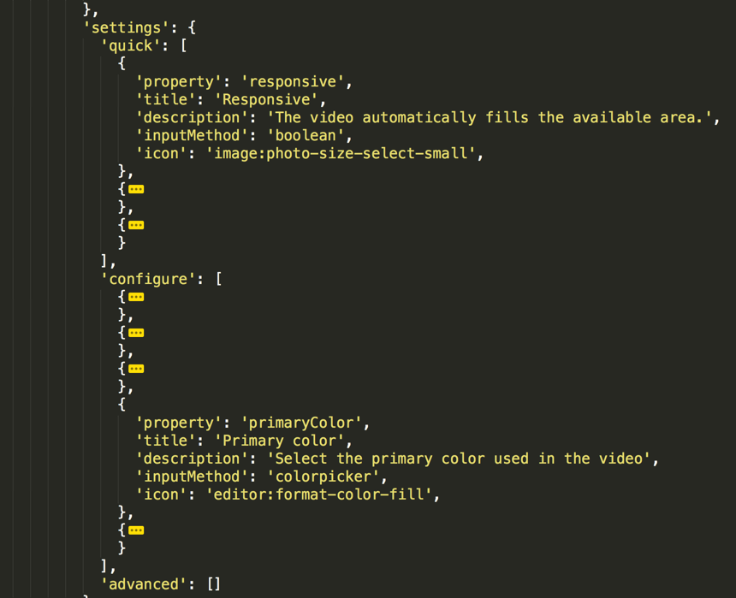
Gizmo JSON: Form fields

Slide 57
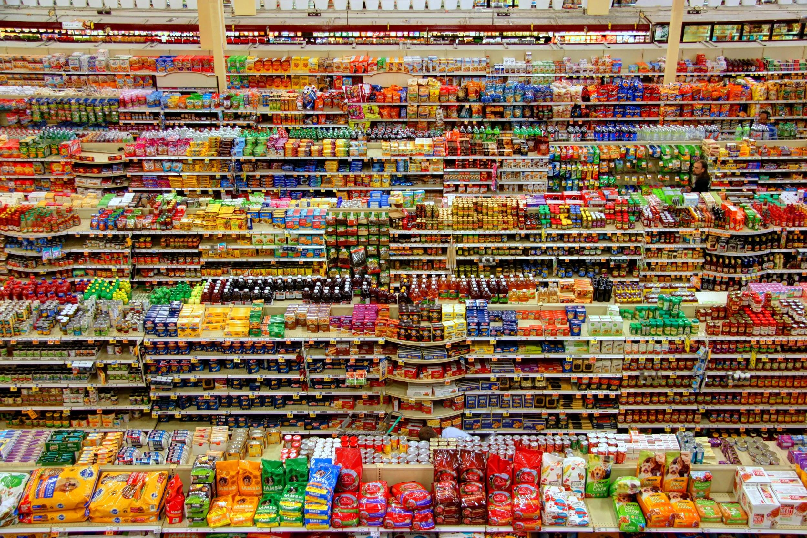
HAX APp store
Photo by Peter Bond on Unsplash

Slide 58
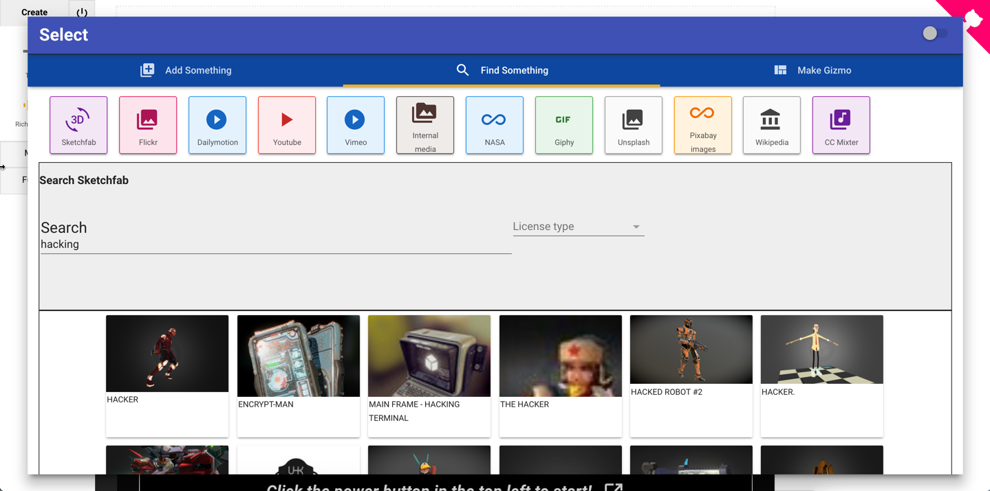
HAX APp Store
HAX brings the internet to us where we are!

Slide 59
HAX APp
JSON object expresses
What is it (Youtube, icon, red)
How to browse it (api endpoint, keys, etc)
How to map to a preview
What gizmo type it supplies (video, image, etc)
What properties it supplies (title, alt, source, citation)

Slide 60
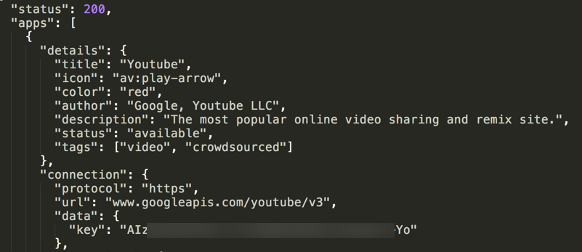
HAX APp

Slide 61
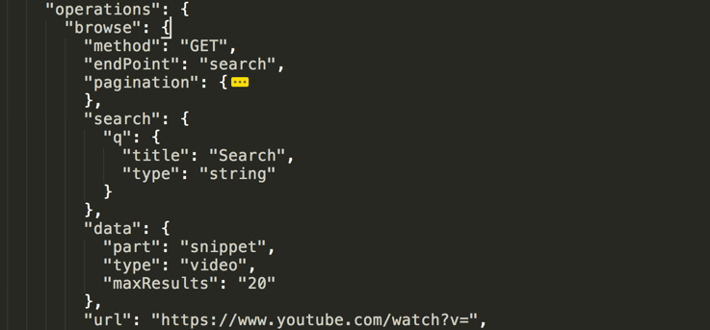
HAX APp

Slide 62
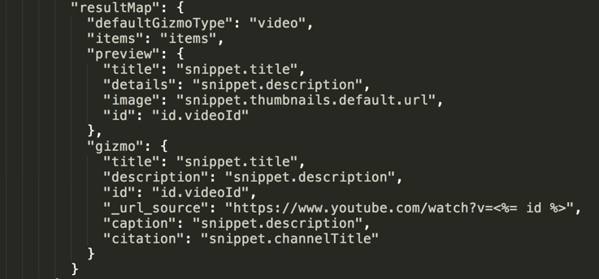
HAX APp

Slide 63
HAXtheweb.org

Slide 64
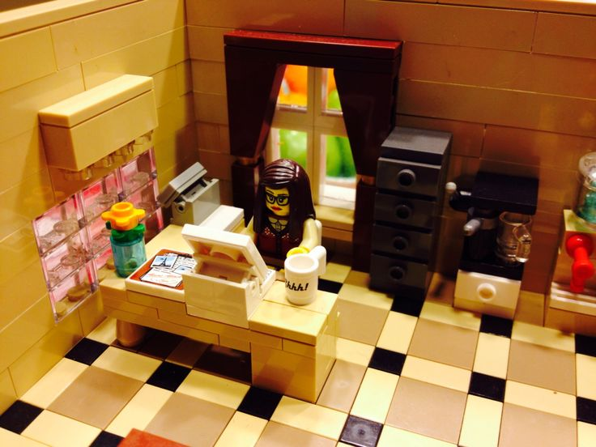

HAX Desktop App

Slide 65


The future is you!

Slide 66
Let’s work together
No matter what system we use!

Slide 67

Michael Potter @hey__mp
Penn State Eberly College of Science

Slide 68
Zane
Sensenig @ZaneSensenig
Penn State Smeal College of Buisiness

